Slide 1


Ivan K Ivanov
7/19/2023

Slide 2

Outline
Executive Summary
Introduction
Methodology
Results
Conclusion
Appendix

Slide 3
Executive Summary
Summary of methodologies
Summary of all results

Slide 4
Introduction
This project is focused on predicting if the Falcon 9 Booster will successfully land after launch
All data used in the analysis is provided by SpaceX

Slide 5

Section 1

Slide 6
Methodology
Executive Summary
Data collection methodology:
Data is collected through the SpaceX API for real-time information on missions. SQL databases store and retrieve the data efficiently. Supplementary data from svc files enriches the dataset for comprehensive analysis.
Perform data wrangling
Data wrangling is the process of gathering, transforming, and preparing raw data from different sources to create a structured and usable dataset for analysis and modeling.
Perform exploratory data analysis (EDA) using visualization and SQL
Perform interactive visual analytics using Folium and Plotly Dash
Perform predictive analysis using classification models Predictive analysis using classification models involves utilizing algorithms to categorize data into predefined classes, enabling predictions and pattern recognition.

Slide 7
Data Collection
The SpaceX API at https://api.spacexdata.com/v4 provides real-time data on SpaceX missions in JSON format through HTTP requests.
To transform the JSON data into a structured format for analysis, Python's pandas library offers the `read_json()` function, converting it into a DataFrame.
Data from SQL databases is accessed using SQL queries through Python libraries, while svc files can be read directly into pandas DataFrames using the `read_csv()` function for analysis.

Slide 8
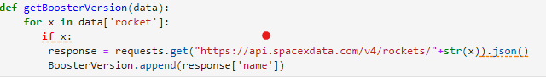
Data Collection – SpaceX API
With the API calls were reached the the following endpoints
- Booster version
https://api.spacexdata.com/v4/rockets/
- Launch Site
https://api.spacexdata.com/v4/launchpads/
- Payload
https://api.spacexdata.com/v4/rockets/
- GitHub:
https://github.com/IvanKrumov/DS_Capstone_Project/blob/main/jupyter-labs-spacex-data-collection-api.ipynb

Slide 9
Data Collection - Scraping
Present your web scraping process using key phrases and flowcharts
Add the GitHub URL of the completed web scraping notebook, as an external reference and peer-review purpose
Place your flowchart of web scraping here

Slide 10
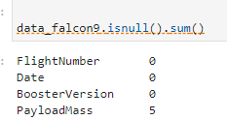
Data Wrangling
Data wrangling from a JSON file involves loading the JSON data, understanding its structure, extracting relevant information, and converting it into a structured format like a DataFrame for further analysis and modeling.
https://github.com/IvanKrumov/DS_Capstone_Project/blob/main/jupyter-labs-webscraping.ipynb

Slide 11
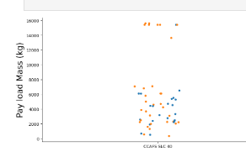
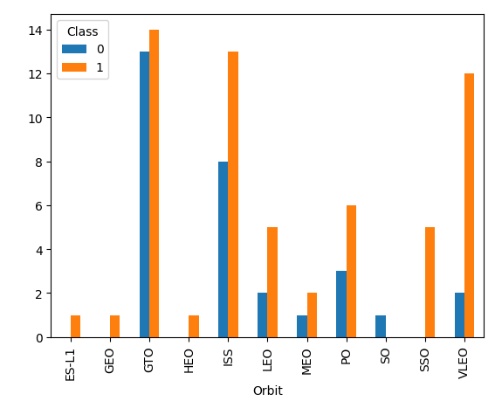
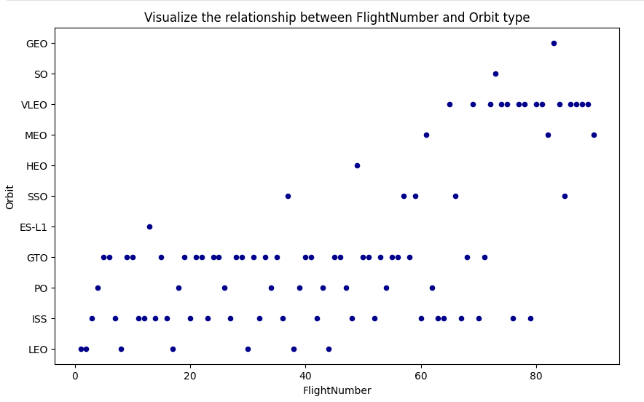
EDA with Data Visualization
In data science, scatter plots are used to visualize the relationship between two variables, displaying individual data points on a two-dimensional plane. Line plots depict the trend or progression of data points over time or across a continuous variable, while bar charts represent categorical data by displaying rectangular bars with heights proportional to the data's frequency or value.
https://github.com/IvanKrumov/DS_Capstone_Project/blob/main/jupyter-labs-eda-dataviz.ipynb.jupyterlite.ipynb

Slide 12
EDA with SQL
select distinct(Launch_Site) from SPACEXTBL;
select * from SPACEXTBL where Launch_Site like 'CCA%’;
select sum(PAYLOAD_MASS__KG_) from SPACEXTBL where Customer == 'NASA (CRS)’ ;
select min(Date) from SPACEXTBL where Mission_Outcome == 'Success’ ;
select distinct(Booster_Version) from SPACEXTBL where Mission_Outcome == 'Success' AND \
(PAYLOAD_MASS__KG_ > 4000 AND PAYLOAD_MASS__KG_ < 6000) AND Landing_Outcome=='Success (drone ship)’;
select count(Landing_Outcome) from SPACEXTBL where Landing_Outcome == 'Success' or Landing_Outcome == 'Failure’;
sql select * FROM SPACEXTBL where (Landing_Outcome == 'Success (ground pad)' or Landing_Outcome == 'Failure (drone ship)' AND Date between '06/04/2010' \
AND '20/03/2017') GROUP BY Landing_Outcome ORDER BY COUNT(Landing_Outcome) DESC
Add the GitHub URL of your completed EDA with SQL notebook, as an external reference and peer-review purpose
https://github.com/IvanKrumov/DS_Capstone_Project/blob/main/jupyter-labs-eda-sql-coursera_sqllite.ipynb

Slide 13
Build an Interactive Map with Folium
In this project's map visualization, I opted for the folium library, a powerful tool for creating interactive maps in Python. To represent the launch sites, I employed circles as markers on the map. Each circle marker was customized to signify a specific launch site, and I added tags or labels to provide clear identification of these sites. This approach allowed viewers to easily discern and associate the launch locations with the corresponding markers on the map, enhancing the overall clarity and usability of the visualization.
Add the GitHub URL of your completed interactive map with Folium map, as an external reference and peer-review purpose https://github.com/IvanKrumov/DS_Capstone_Project/blob/main/lab_jupyter_launch_site_location.jupyterlite.ipynb

Slide 14
Build a Dashboard with Plotly Dash
Within the Plotly Dash board, I incorporated two interactive components, including a dcc.Dropdown menu enabling users to select from a list of launch sites. Additionally, a dcc.RangeSlider was implemented, offering users the ability to adjust the payload range. As part of the dashboard, the data was presented using scatter plots and pie charts, fostering intuitive data exploration and analysis.
Add the GitHub URL of your completed Plotly Dash lab, as an external reference and peer-review purpose https://github.com/IvanKrumov/DS_Capstone_Project/blob/main/spacex_dash_app.py

Slide 15
Predictive Analysis (Classification)
The process will involve data preprocessing to standardize the data, followed by the Train_test_split method to divide the data into training and testing sets. The model training will include performing Grid Search to find optimal hyperparameters for improved performance. We will evaluate the accuracy of different models, including Logistic Regression, Support Vector Machines, Decision Tree Classifier, and K-nearest neighbors, using the training data. Finally, we will generate a confusion matrix to assess the models' performance.
Add the GitHub URL of your completed predictive analysis lab, as an external reference and peer-review purpose https://github.com/IvanKrumov/DS_Capstone_Project/blob/main/SpaceX_Machine_Learning_Prediction_Part_5.jupyterlite.ipynb

Slide 16
Results
Exploratory data analysis results
Interactive analytics demo in screenshots
Predictive analysis results

Slide 17

Section 2

Slide 18
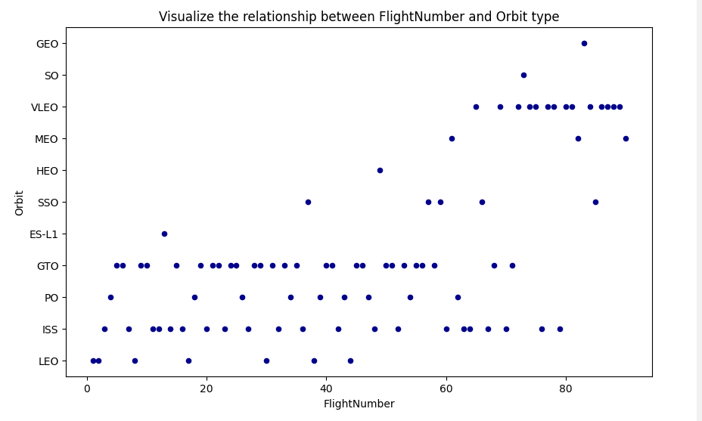
Flight Number vs. Launch Site

Slide 19
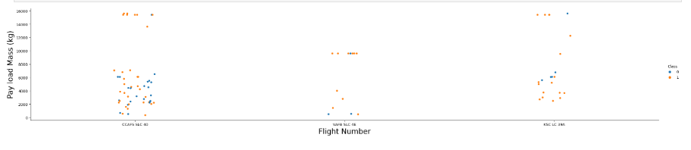
Payload vs. Launch Site

Slide 20
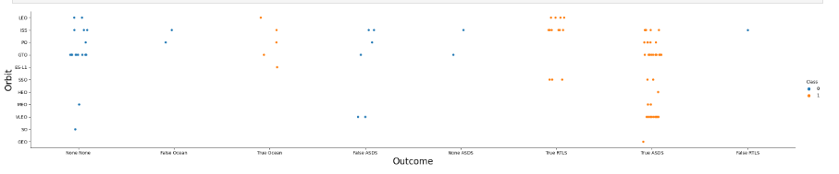
Success Rate vs. Orbit Type

Slide 21
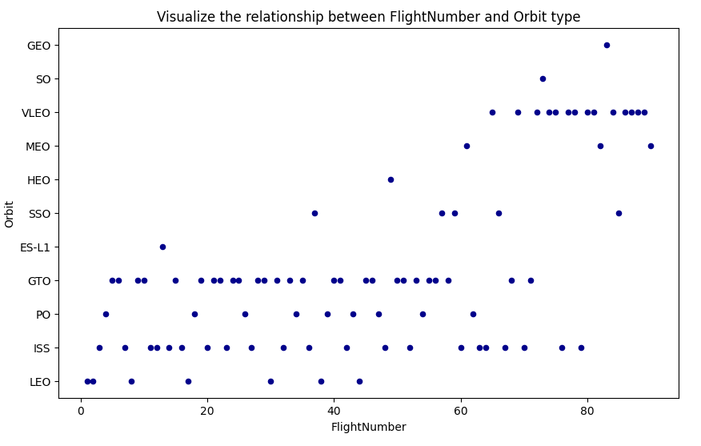
Flight Number vs. Orbit Type

Slide 22
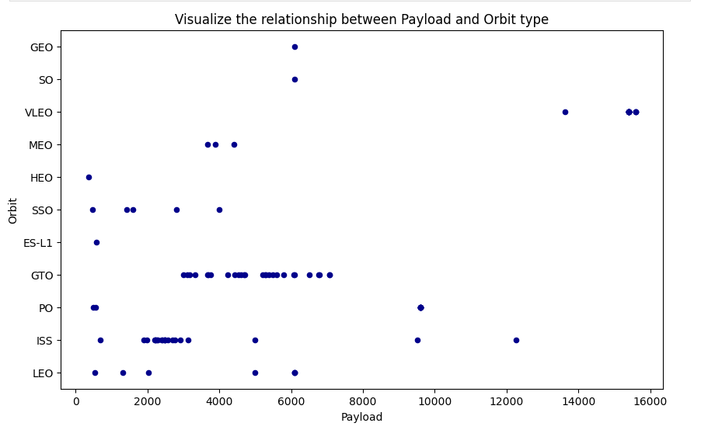
Payload vs. Orbit Type

Slide 23
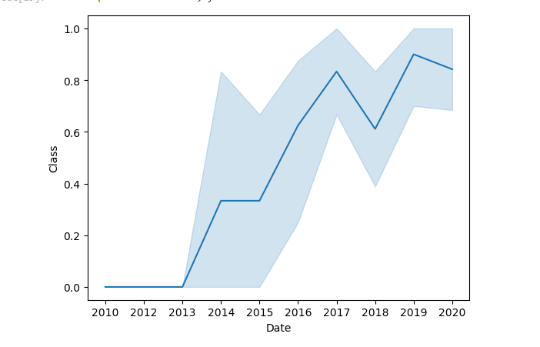
Launch Success Yearly Trend

Slide 24
All Launch Site Names
df = pd.read_sql_query("select distinct(Launch_Site) from SPACEXTBL;", con)
#print the dataframe
df

Slide 25
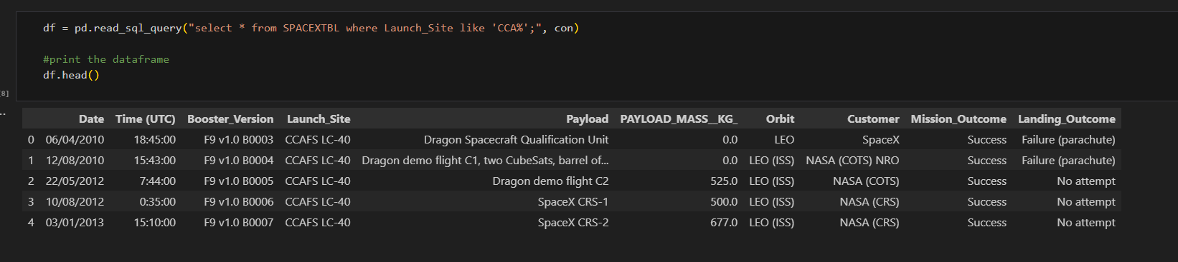
Launch Site Names Begin with 'CCA'

Slide 26
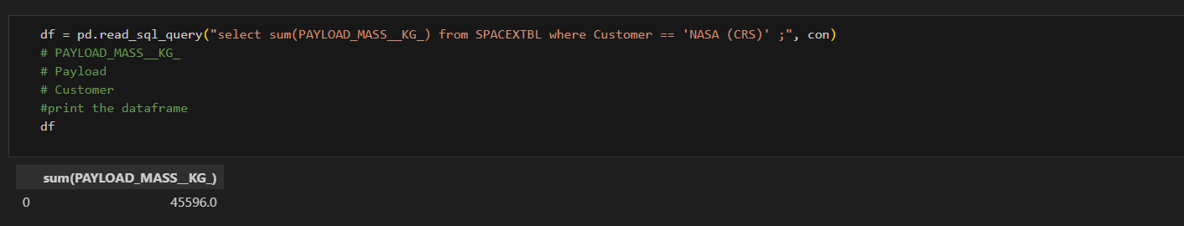
Total Payload Mass

Slide 27
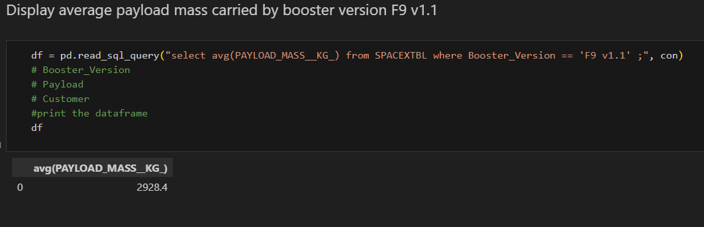
Average Payload Mass by F9 v1.1

Slide 28
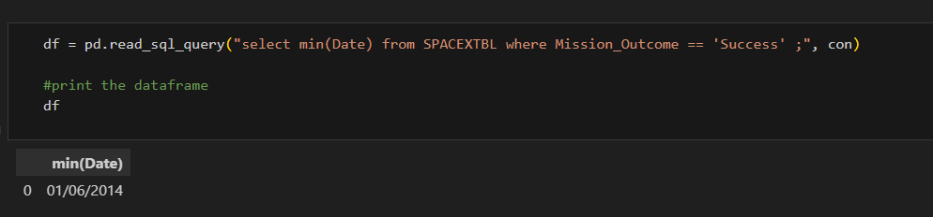
First Successful Ground Landing Date

Slide 29
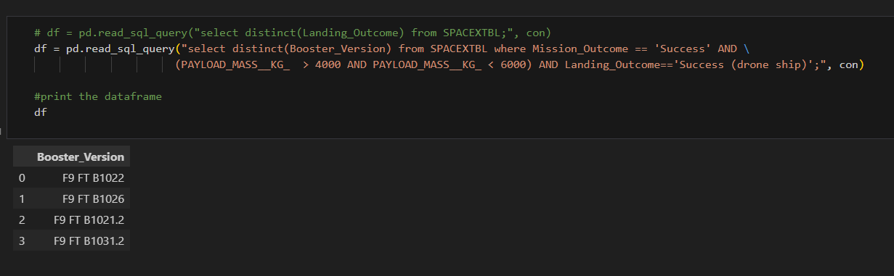
Successful Drone Ship Landing with Payload between 4000 and 6000

Slide 30
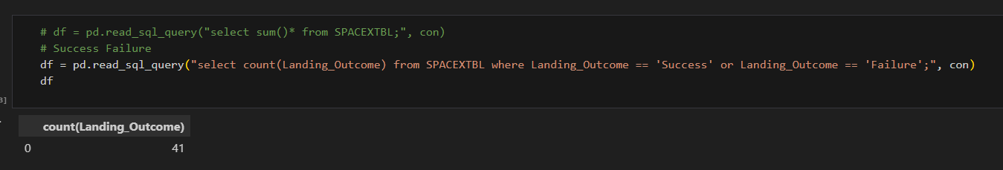
Total Number of Successful and Failure Mission Outcomes

Slide 31
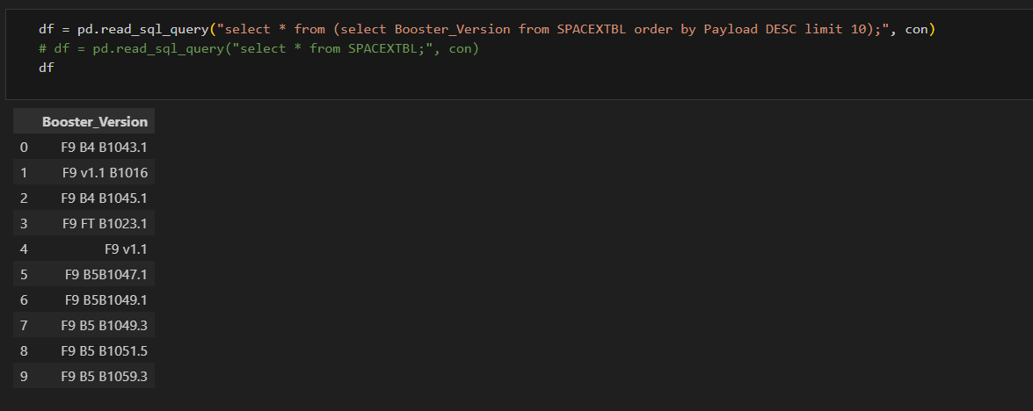
Boosters Carried Maximum Payload

Slide 32
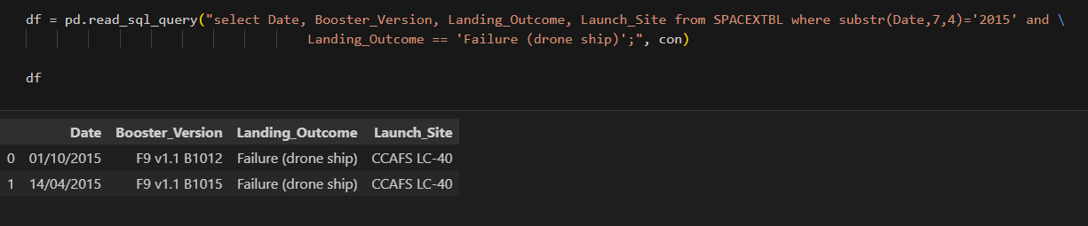
2015 Launch Records

Slide 33
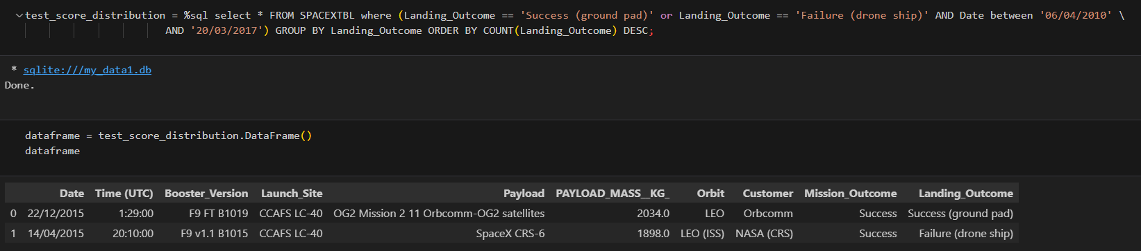
Rank Landing Outcomes Between 2010-06-04 and 2017-03-20

Slide 34

Section 3

Slide 35
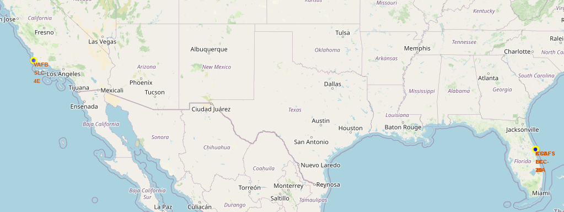
SpaceX Launch Sites

Slide 36
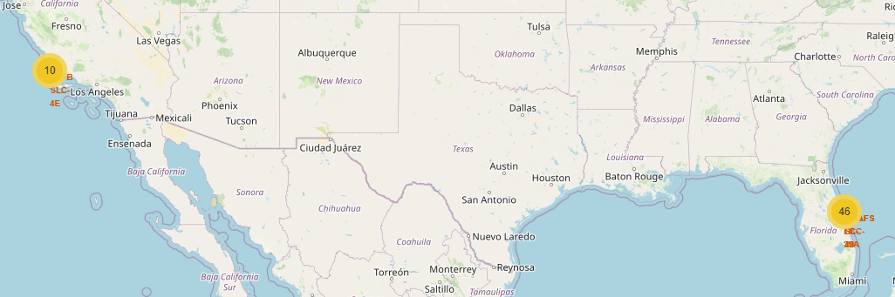
SpaceX Successful Launch Map

Slide 37
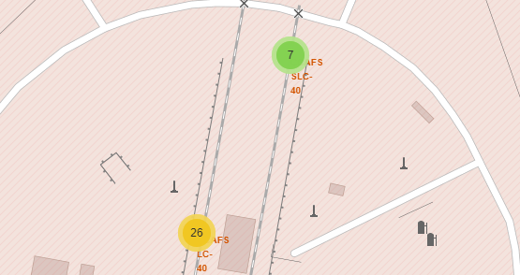
SpaceX Detailed Diagram

Slide 38

Section 4

Slide 39
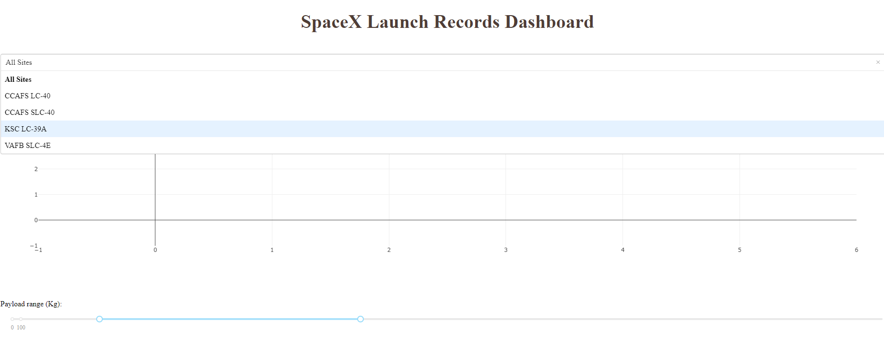
Dashboard Menu

Slide 40
<Dashboard Screenshot 2>
Replace <Dashboard screenshot 2> title with an appropriate title
Show the screenshot of the piechart for the launch site with highest launch success ratio
Explain the important elements and findings on the screenshot

Slide 41
<Dashboard Screenshot 3>
Replace <Dashboard screenshot 3> title with an appropriate title
Show screenshots of Payload vs. Launch Outcome scatter plot for all sites, with different payload selected in the range slider
Explain the important elements and findings on the screenshot, such as which payload range or booster version have the largest success rate, etc.

Slide 42

Section 5

Slide 43
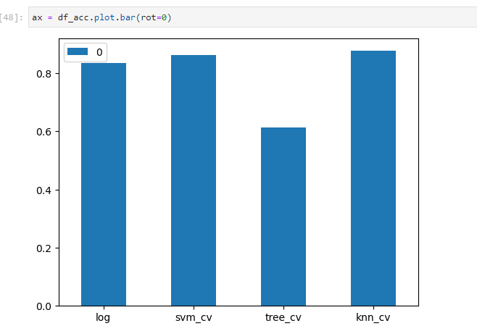
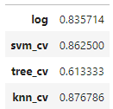
Classification Accuracy

Slide 44
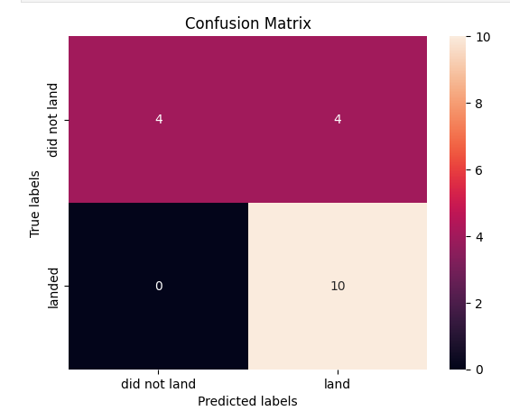
Confusion Matrix

Slide 45
Conclusions
KNN Model has highest model accuracy
KNN Model has best performing Confusion Matrix
According to all data Falcon 9 will lend

Slide 46
Appendix

Slide 47


